Slide 1

Chapter Two:
Review of the Literature

Slide 2

Chapter Outline
Review of the Literature
The Research Topic
The Literature Review
The Use of the Literature
Design Techniques
Steps in Conducting a Literature Review Searching Computerized Databases
A Priority for Selecting Literature Material
A Literature Map of the Research
Abstracting Studies
Example 2.1. Literature Review Abstract in a Quantitative Study
Example 2.2. Literature Review Abstract in a Study Advancing a Typology
Style Manuals
The Definition of Terms
Example 2.3. Terms Defined in an Independent Variables Section
Example 2.4. Terms Defined in a Mixed Methods Dissertation
A Quantitative or Mixed Methods Literature Review

Slide 3
The Research Topic
  A critical first step in any research is examining the existing body of knowledge on the research topic/idea, and it will assist the Researcher with all of the following:
The subject or subject matter of a proposed study
  Describe in a few words
  The central idea you want to learn about
The topic can be researched if
  You have access to participants
  You have resources to collect and analyze information
The topic should be researched if
  The research will add to the literature about the topic
  Scholars will be interested in the topic
  A study of it will advance your personal goals

Slide 4
The Literature Review
Shares the results of other studies
Relates the study to the larger dialogue in the literature
Provides a framework for establishing the importance of the study
Provides a benchmark for comparing the results to other findings

Slide 5
The Use of Literature
The use and length of the literature varies based on the forum: research proposal, dissertation or journal article. Despite this, the literature may:
  provide a summary of major studies on the research problem
  demonstrate the writers knowledge of the topic/problem/issue
  integrate what others have done and said about the topic/problem/issue
  may criticize previous scholarly works on the topic/problem/issue
  may allow for connections between related topics
  may elucidate the central issues in the field

Slide 6
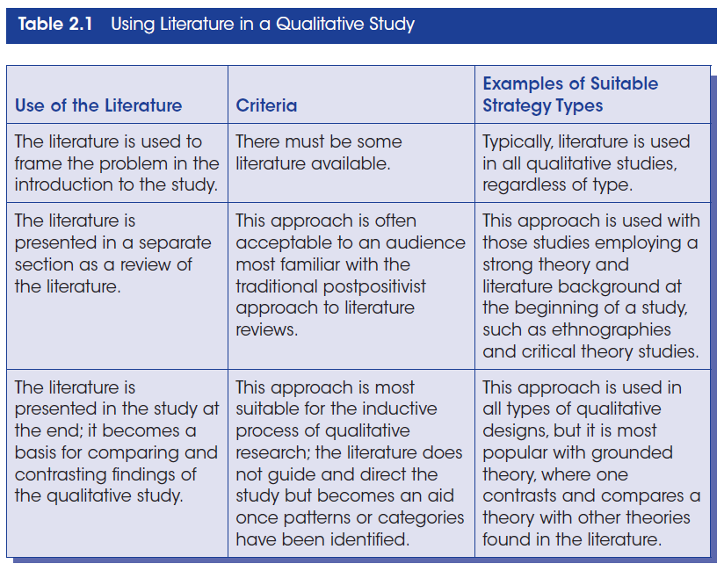
Using Literature in a Qualitative Study

Slide 7
The Use of Literature in a Quantitative Study
In quantitative studies the literature is used deductively as it provides a framework for the research questions and hypothesis
  Provide direction to the research questions and hypotheses
  Introduce a problem
  Introduce and describe the theory that will be used
  Examine the usefulness of the theory
  Compare results with existing literature or predictions

Slide 8
The Use of Literature in a Mixed Methods Study
In mixed methods studies Researchers use the literature:
  in either a quantitative or qualitative approach
  in a manner consistent with either quantitative or qualitative approach
  relative to the intended audience
  Irrespective of the type of study, choose one of the following types of literature reviews:
  Integrative
  Critical
  Building bridges among topics
  Identification of central issues

Slide 9
Steps in Conducting a Literature Review
Identify key words
Search library catalogs
Identify about 50 research reports in articles or books
Photocopy those that are central to your topic
Design a literature map
Draft summaries of the relevant articles
Write a literature review, organizing it by important concepts

Slide 10
Searching Computerized Databases
Computerized databases are readily available through libraries and the internet.
These databases provide access to numerous journal articles, conference papers and dissertations on a wealth of topics.
Some of these online data bases include:
ERIC - ProQuest - EBSCO
Sociological Abstracts - PsycINFO - PubMed
Science direct - Google scholar
-Social Science Citation Index (SSCI)

Slide 11
Searching Computerized Databases
Cont.
Use both free databases and those subscribed for by academic libraries
Search several databases, even those outside your field
Do not use only search terms that are identical to your topic and study interest, slight variations in the search terms may yield more outcomes
Locate articles that are close to your topic and use their descriptors to enhance your search
Use databases that provide access to full articles

Slide 12
Selecting Literature Material
Start with broad syntheses (such as encyclopedias) if you are new to the topic
Turn to journal articles in national journals
  Best source for research reports
Next consider books
Then examine conference papers
Scan for dissertations
Last consider reports on the web

Slide 13
Literature Map of Research
A literature map is a visual summary of existing research on a topic
The structure of the literature map may be:
  a hierarchical pattern
  a flowchart layout
  a series of circles

Slide 14
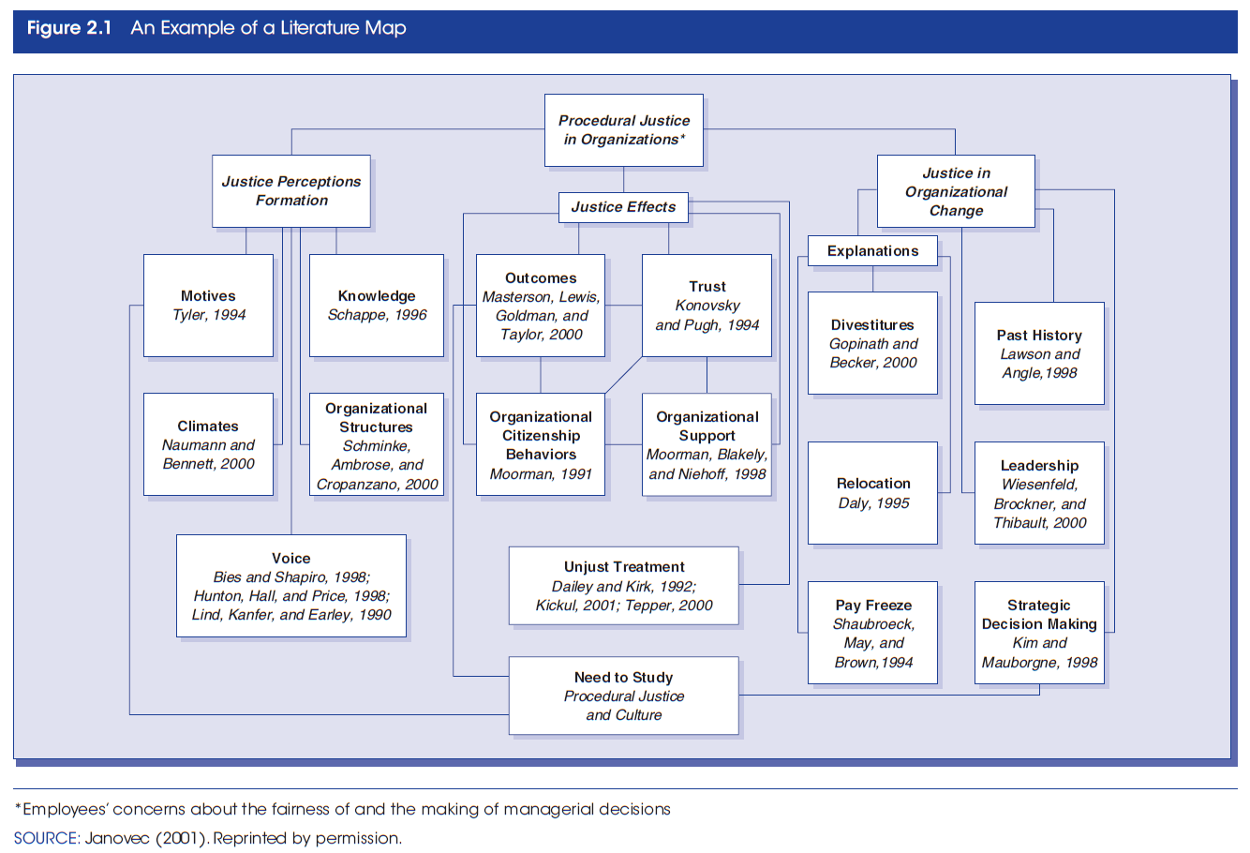
An Example of Literature Map

Slide 15
Abstracting Studies
Draft abstracts that summarize selected articles
For research studies:
  Mention the problem
  State the central purpose
  State information about the population and sample
  Review key results
  Point out methodological flaws (if a methodological review)
For nonempirical studies (essays, opinions, etc.)
  Mention the problem
  State the central theme
  State the major conclusions
  Mention flaws in reasoning or logic (if a methodological review)

Slide 16
Style Manuals
Style manuals provide guidelines for producing scholarly work and include directions on the following:
  Citing references
  Creating headings
  Presenting tables and figures
  In-text citation/references
  End-of-text references
  Footnotes (not used in all style manuals)
  Reminder: Consistently use the chosen style manual

Slide 17
The Definition of Terms
Identify and define terms that readers need to understand a proposal
Define terms introduced in all sections of the research plan
  The title of the study
  The problem statement
  The purpose statement
  The research questions, hypotheses, or objectives
  The literature review
  The theory base of the study
  The methods section

Slide 18
The Definition of Terms Cont.
Qualitative studies are inductive and evolutionary in nature hence the definition of terms may appear later in the written report, perhaps in the data analysis.
Quantitative studies are deductive with a fixed set of objectives, hence all relevant terms are comprehensively defined earlier in the study.
In Mixed methods studies the definition of relevant terms follows the use of (earlier or later in the study) and emphasis placed on quantitative and qualitative approaches.

Slide 19
The Definition of Terms Cont.
Define terms when they first appear in the manuscript
Use specific operational definitions
Do not define terms using everyday language, be guided by the literature
Define terms so that they accomplish different goals
One may use a definition of terms section in the manuscript

Slide 20
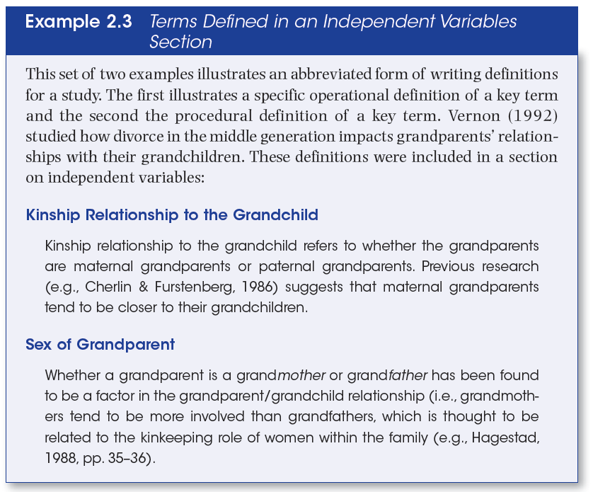
The Definition of Terms Cont.

Slide 21
A Quantitative or Mixed Methods Literature Review
A suggested model
  Introduce the review with a statement about the organization of the sections
  Review literature about the independent variables
  Review literature about the dependent variables
  Review literature that relates the independent variables to the dependent variables
  Provide a summary
    Highlight important studies
    Capture major themes
    Suggest why more research is needed
    Advance how the proposed study will fill this need

